Slide 1
Data Center Security Overview
Dr. Natheer Khasawneh
Ziad BashaBsheh

Slide 2
Data Center Security Overview
Provides an overview of the typical security issues that affect DCs and presents the general guidelines to secure DC in a systematic manner that helps maintain as adequate security level as the DC evolves.
The Importance of security policies, secure management, incident response, and attack mitigation.
The Need for a Secure Data Center
Losing data and applications can impact the organization’s ability to conduct business.
The large volume of information and the criticality of the services housed in DCs make them likely target.
Denial of Service, theft of confidential information, data alteration, and data loss are some of the common security problems afflicting Data Center Environments.

Slide 3
Data Center Security Overview (cont)
The Need for a Secure Data Center
Applications become more complex, there are more chances for inconsistent installations.
Hackers use the openness of the internet to communicate and develop automated tools the facilitate the identification and exploitation of those vulnerabilities.
Many attacks tools are widely available on the internet and are designed to execute highly sophisticated attacks using simple user interfaces.

Slide 4
Vulnerabilities & Common Attack
The following terms are important to define in the context of security in data centers:
Threat – An event that poses some harm to the data center or its resources
Vulnerability – A deficiency on a system or resources whose exploitation leads to the materialization of the threats
Attack – the actual exploitation of a vulnerability to make threat reality.
-----
Threats
The following are some of the most common threats to Data Center:
DoS.
Breach of Confidential Information.
Data theft or alteration.
Unauthorized use of Compute resources.
Identify theft.

Slide 5
Vulnerabilities & Common Attack (cont)
Vulnerabilities – Most of Vulnerabilities found today originated in at least one of the following areas:
Implementation – Software and protocols flows, incorrect or faulty software design, incomplete testing, etc.
Configuration - Elements not properly configured, use of default, and so on.
Design – ineffective or inadequate security design, lack of or inappropriate implementation of redundancy mechanisms, etc.
common source Problems:
Exploitation of Out-of-Date software.
Exploitation of software default.

Slide 6
Vulnerabilities & Common Attack (cont)
Common attacks – After talking about Threats and Vulnerabilities, we will discuss how they are exploited by the most frequent attacks.
Scanning or Probing – this activity precedes an attack to gain access by discovering information about system or network.
- The term of probe refers to an individual attempts, whereas a scan consists of a large number of probes by an automated tool.
DoS- the goal of DoS attack is to degrade service to the point that legitimate users are unable to conduct their regular activities.
- Ex: SYN flood ( TCP ) , Smurf attack(ICMP), Ping of Death (ICMP).
DDoS – Distributed denial of service attacks are a particular case of DoS attacks where a large number of systems are compromised
Ex-Tools: Trinoo, Tribe Flood Network (TFN), Stacheldraht.
Similarly to Dos attacks in Data Centers, DDoS attacks target servers rather than the network infrastructure.

Slide 7
Vulnerabilities & Common Attack (cont)
Common attacks – ( Continued…)
Unauthorized access– consists of gaining access to restricted resources by using a valid account or a backdoor.
- Ex: network intrusion( external intruder gain access to internal network resources), Backdoors, IP Spoofing.
Eavesdropping - is the unauthorized interception of information that travels on the network, this information might contain confidential data such as username and password. Another example is packet capturing.
Viruses & Worms – both cases of malicious code, hidden in the system until the damage is discovered.
The difference between viruses and worms is the way they auto-replicate, Worms are also self-replicating programs that propagate without any human intervention.
Viruses are also self-replicating programs but need kind of action.
- Ex: CodeRed, Nidma, SQL Slammer (are Examples to worms).

Slide 8
Vulnerabilities & Common Attack (cont)
Common attacks – ( Continued…)
Internet infrastructure attack– target to internet infrastructure rather than individual systems or networks.
Ex: DNS attacks, Ping flood, all kinds of DDoS.
Trust Exploitation - these attacks exploit the trust relationships that computer systems have to communicate.
Communications in networked environments are always based on trust. For example; when a web-server communicates with a back end database.
Session Hijacking – consists of stealing a legitimate session established between a target and trusted host.
Ex: IP spoofing, TCP SYN/ACK.
Buffer overflow attacks – occurs when a program allocates memory buffer space beyond what it had reserved.

Slide 9
Vulnerabilities & Common Attack (cont)
Common attacks – ( Continued…)
Layer 2 attacks– exploits the vulnerabilities of data link layer protocols and their implementations on layer 2 switching platforms, one of the characteristics of layer 2 attacks is that the attacker must be connected to the same LAN as the victims.
Ex: Address Resolution Protocol (ARP) Spoofing, MAC Flooding.

Slide 10
Network Security Infrastructure
The network security infrastructure includes the security tools used in the Data Center to enforce security policies. The tools include packet-filtering technologies such as ACLs and firewalls and intrusion detection systems (IDSs) both network-based and host-based. The following sections discuss these security tools.
ACLs– are filtering mechanisms explicitly defined based on packet harder information to permit or deny traffic on specific interfaces.
An ACL is typically set up as a list that is applied sequentially on the packets until a match is found.

Slide 11
Network Security Infrastructure (cont)
FireWalls– are a sophisticated filtering device that separates LAN segments.
The considerations are as follows:
Performance,
Application support,
There are different types of firewalls based on their packet-processing capabilities and their awareness of application-level information:
Packet-filtering firewalls.
Proxy firewalls.
Stateful firewalls.
Hybrid firewalls.

Slide 12
Network Security Infrastructure (cont)
IDSs– are real time systems that can detect intruders and suspicious activities and report them to a monitoring system.
IDSs have two fundamental components:
Sensors, Appliances and software agents that analyze the traffic on the network or the resource usage on end systems to identify intrusions and suspicious activities. Sensors can be network-based or host-based.
IDS management, Single- or multi-device system used to configure and administer sensors and to additionally collect all the alarm information generated by the sensors
Typical IDS response Actions
Most IDSs are capable of responding to identified security incidents using specific mechanisms:
IP session Login – This response is the least aggressive response and consists of logging the entire IP session that corresponds to a detected intrusion.
TCP rests- you can configure the IDS to generate TCP rests on behalf of a victim system.
Shunning or blocking- The IDS can instruct a network device such as a router, switch, or firewall to dynamically apply an ACL to block the traffic coming from an attacker.

Slide 13
Network Security Infrastructure (cont)
Layer 2 Security–
components:
Port Security, is a feature that permits you to configure a switch port to only accept packets coming with a trusted source MAC address.
ARP Inspection, is a feature that lets you specify the mapping between the default gateway IP address and its MAC address, this process prevents ARP spoofing attacks known as man-in-the-middle attacks.
Private VLANs – permit the isolation of ports from one another within the same VLAN.

Slide 14
Security Fundamentals
This section discusses fundamental security concepts such as encryption, AAA ( Authentication, Authorization, and accounting; and VPNs.
components:
Cryptography, is simply the science of encryption and decrypting information, secure transactions from client to server, secure communication between a user and managed device, and secure communication channel between two sites, and so on.
Cryptography is typically associated with :
Confidentiality.
Integrity.
Nonrepudiation.
Authentication.
Antireplay protection. - used at the IP packet level to ensure that packers are not intercepted, modified, and inserted back in the communication stream between client and server.

Slide 15
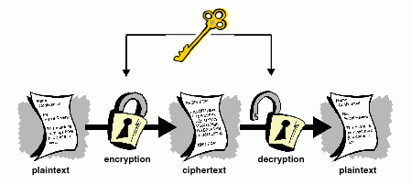
Security Fundamentals (cont)
Data Center security uses encryption with two primary purposes:
To protect the confidentiality of user’s data
To secure the communications over the management infrastructure
Encryption algorithms:
Symmetric encryption.

Slide 16
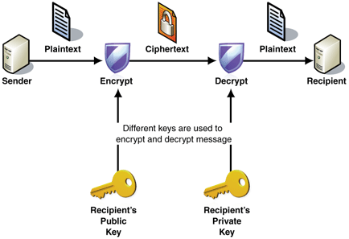
Security Fundamentals (cont)
Encryption algorithms:
Asymmetric encryption. For Confidentiality

Slide 17
Security Fundamentals (cont)
VPN – Virtual Private Networks.
Described as a virtual link between two entities that allows them to communicate securely over a public network like the internet.
VPN use tunneling technologies combined with encryption and authentication services.
There are two main applications for VPN:
Site-to-Site- provides the communication between two distinct locations using routers or VPN concentrators.
Remote access- allows remote users to access a central location via a secure communication channel between end users and VPN router or VPN concentrator.

Slide 18
Security Fundamentals (cont)
AAA.
AAA is a framework that defines the control of access to network resources such as those in Data Centers (routers, switches, firewalls, servers, and so on).
AAA provides three basic services:
Authentication – proves that a user is who she or he claims to be.
Authorization- Defines what a user is allowed to do.
Accounting – Consists of keeping records of user activity.

Slide 19
Data Center Security Framework
Data Center Security Framework.
This section explains the key components of a sound security framework from a system-planning perspective. Because the details of applying these components to the network are driven by the particular business needs of an organization
Security Policies - The security policy defines what activities are considered acceptable or unacceptable by the organization.
Security Life Cycle – is the constant evaluation cycle that refines the state of security readiness and adapts the security policy to the network architecture.

Slide 20
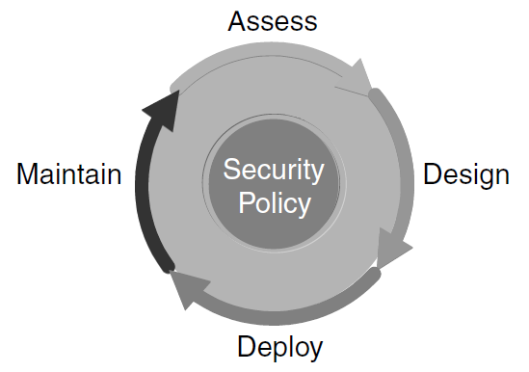
Data Center Security Framework (cont)
The following security life cycle is often quoted and well understood in the security industry:
Assess
Design
Deploy
Maintain

Slide 21
Data Center Security Framework (cont)
Assessment – The process of auditing, testing, and verifying the system vulnerabilities through risk analysis.
Design - The process of applying the security policy and requirement resulting from the assessment process to the security design.
Deployment - The process of the implementing the specific security design recommendation into the network architecture.
Maintenance - The process of keeping the application of security policies consistent through out the network by monitoring that the best practices and recommendations, are in effect.

Slide 22
Data Center Security Framework (cont)
Secure Management Framework: The following steps help you for more securing:
Isolating the Management infrastructure -
Encryption of Control Data –
Strong Authentication for Access Control -

